Slide 1
चरैवेति, चरैवेति
Keep progressing to attain a higher self.
avinash.bhagat@lpu.co.in Avinash Bhagat 9463281930

Slide 2
CAP275: Data Communication and Networking
Lecture 1
avinash.bhagat@lpu.co.in Avinash Bhagat 9463281930

Slide 3
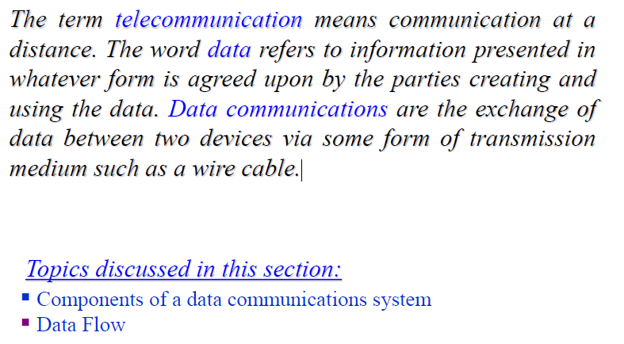
d(t) s(t) d(t) s’(t)
d(t) s(t) d’(t) s’(t)
d(t) s(t) d’(t) s’(t)
DATA COMMUNICATIONS

Slide 4
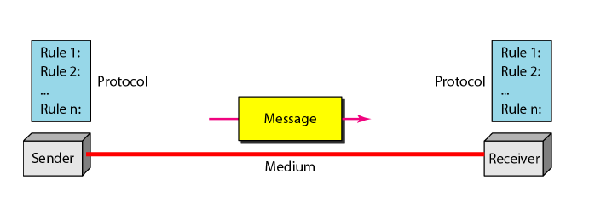
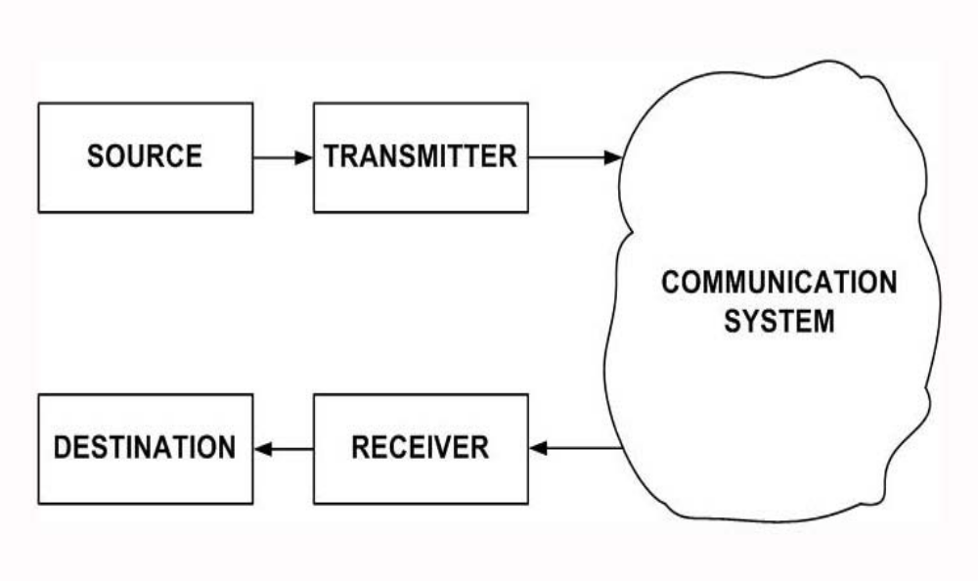

d(t) s(t) d(t) s’(t)
d(t) s(t) d’(t) s’(t)
d(t) s(t) d’(t) s’(t)
DATA COMMUNICATIONS

Slide 5
d(t) s(t) d(t) s’(t)
d(t) s(t) d’(t) s’(t)
d(t) s(t) d’(t) s’(t)
DATA COMMUNICATIONS
Source :
Where the data is originated. It can be a computer, peripherals or communication device like cell phone, PDA or any system which can send data, process data or which can receive data.
Transmitter:
Converts data sent by source into a suitable form for transmission through the medium.

Slide 6
d(t) s(t) d(t) s’(t)
d(t) s(t) d’(t) s’(t)
d(t) s(t) d’(t) s’(t)
DATA COMMUNICATIONS
Communications System:
Medium through which signal is sent. It can be a simple system like pair of wires, coaxial, UTP or fiber or it can be Complex system like LAN , WAN, wireless system

Slide 7
d(t) s(t) d(t) s’(t)
d(t) s(t) d’(t) s’(t)
d(t) s(t) d’(t) s’(t)
DATA COMMUNICATIONS
Receiver:
Which receives the signal from communication system and converts it into data or message after processing
Destination :
Where the data is sent. Can be a computer, peripherals etc

Slide 8
DATA COMMUNICATIONS
Data : d(t)
It refers to information that conveys some meaning based on some mutually agreed up rules or conventions between a sender and a receiver.
Data can be of two types; analog and digital.

Slide 9
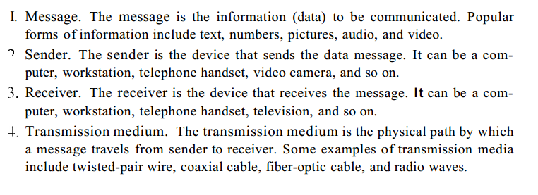


DATA COMMUNICATIONS

Slide 10
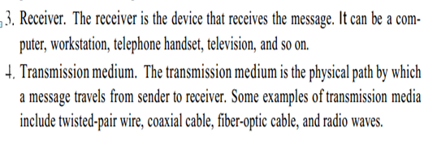
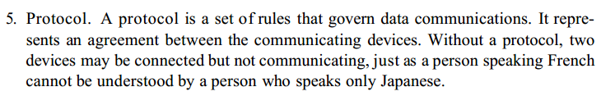
DATA COMMUNICATIONS

Slide 11
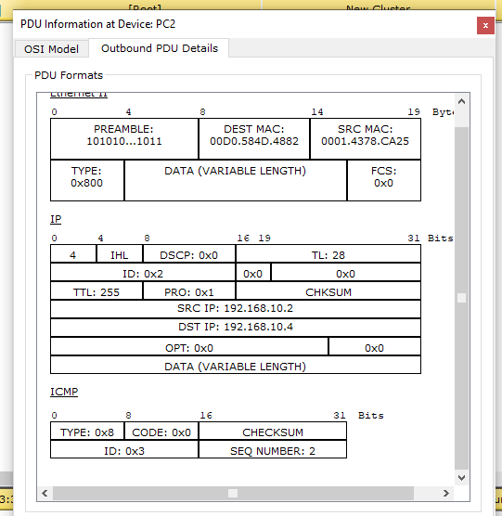
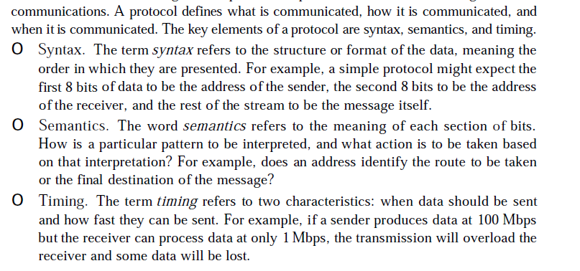
DATA COMMUNICATIONS
Syntax.
The term syntax refers to the structure or format of the data, meaning the order in which they are presented.
    For example, a simple protocol might expect the first 8 bits of data to be the address of the sender, the second 8 bits to be the address of the receiver,
    and the rest of the stream to be the message itself.

Slide 12
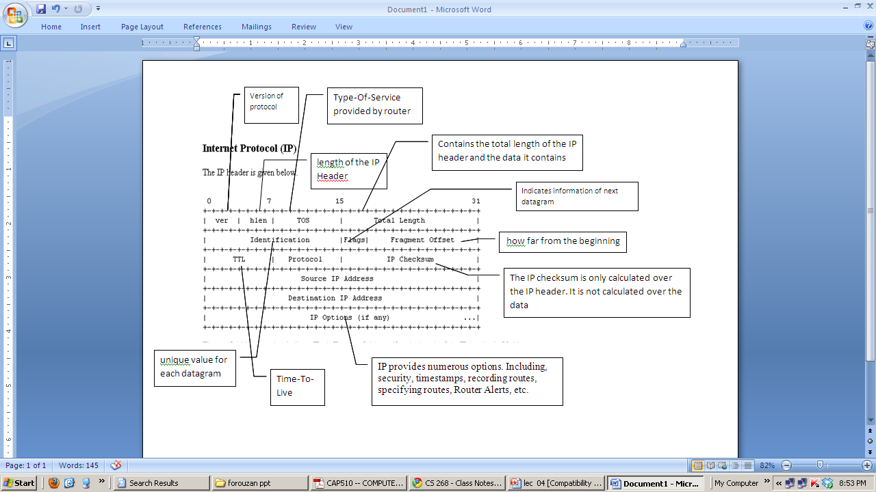
DATA COMMUNICATIONS

Slide 13
DATA COMMUNICATIONS
Semantics.
The word semantics refers to the meaning of each section of bits.
How is a particular pattern to be interpreted,
and what action is to be taken based on that interpretation?

Slide 14
DATA COMMUNICATIONS
Timing. refers to two characteristics:
when data should be sent
How fast they can be sent.
Notes:
Timing.
For example, if a sender produces data at 100 Mbps but the receiver can process data at only 1 Mbps, the transmission will overload the receiver and some data will be lost.

Slide 15
MCQ
The _______ is the physical path over which a message travels.
a. Protocol
b. Medium
c. Signal
d. All the above
Notes:
Timing.
For example, if a sender produces data at 100 Mbps but the receiver can process data at only 1 Mbps, the transmission will overload the receiver and some data will be lost.

Slide 16
MCQ
The information to be communicated in a data communications system is the _______.
a. Medium
b. Protocol
c. Message
d. Transmission
Notes:
Timing.
For example, if a sender produces data at 100 Mbps but the receiver can process data at only 1 Mbps, the transmission will overload the receiver and some data will be lost.

Slide 17
MCQ
_______ refers to the structure or format of the data, meaning the order in which they are presented.
a. Semantics
b. Syntax
c. Timing
d. All of the above
Notes:
Timing.
For example, if a sender produces data at 100 Mbps but the receiver can process data at only 1 Mbps, the transmission will overload the receiver and some data will be lost.

Slide 18
MCQ
________ defines how a particular pattern to be interpreted, and what action is to be taken based on that interpretation.
a. Semantics
b. Syntax
c. Timing
d. None of the above
Notes:
Timing.
For example, if a sender produces data at 100 Mbps but the receiver can process data at only 1 Mbps, the transmission will overload the receiver and some data will be lost.

Slide 19
MCQ
_______ refers to two characteristics: when data should be sent and how fast it can be sent.
a. Semantics
b. Syntax
c. Timing
d. none of the above
Notes:
Timing.
For example, if a sender produces data at 100 Mbps but the receiver can process data at only 1 Mbps, the transmission will overload the receiver and some data will be lost.

Slide 20
Subjective Questions
Q1 What are various components of a data communication model? Explain all the components in detail. [5 marks]
Q2 What is a protocol? What are its components? [5 marks]
Q3 Define protocol and its components. What functions can a protocol performs?
Notes:
Timing.
For example, if a sender produces data at 100 Mbps but the receiver can process data at only 1 Mbps, the transmission will overload the receiver and some data will be lost.

Slide 21


See you in next class

